Slide 1
Running WRF with ERA5
Charles Philip Johnson

Slide 2
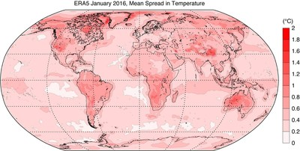
ERA5
Fifth-generation global ECMWF atmospheric reanalysis data.
Available from 1940-present.
Requires single-level data (surface data).
Requires pressure level data (atmospheric data).
Requires Invariant data (static/unchanging data).

Slide 3
Steps
Attaining Data
Pressure level and Surface
Invariant
WPS
Geogrid
Ungrib
Metgrid
WRF
Real
WRF

Slide 4
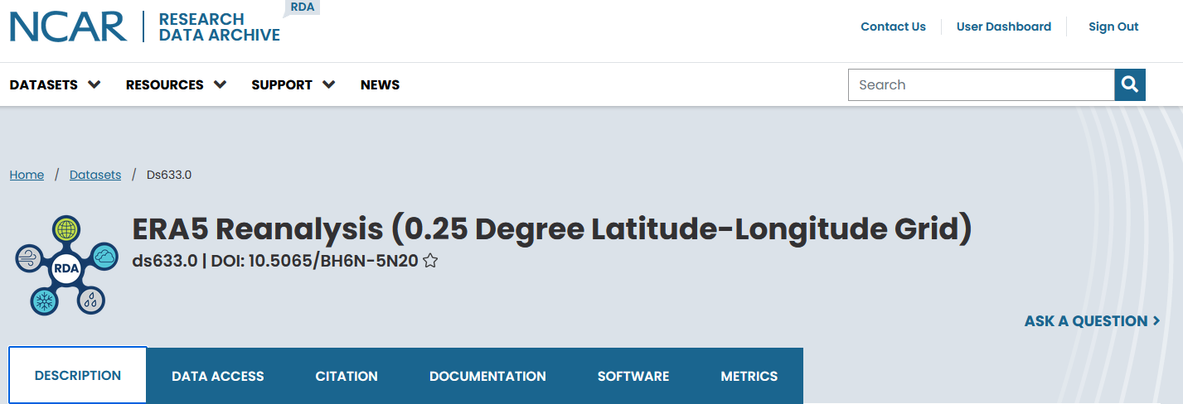
Step 1: Attaining Data
Two sources of retrieving ERA5 Reanalysis data.
https://rda.ucar.edu/datasets/ds633.0/
https://cds.climate.copernicus.eu/cdsapp#!/dataset/reanalysis-era5-single-levels?tab=overview
Either should work, but the first (NCAR/UCAR) is the most common and recommended.
Both will require you to create an account.
Notes:
For those interested, the second allows more specification of variables to download. Useful if you’re substituting things like your own sea surface temperatures. The second also allows you to specify the region for which you’re downloading data. Useful if you have storage constraints, but you don’t really have to worry about that on SMIC

Slide 5
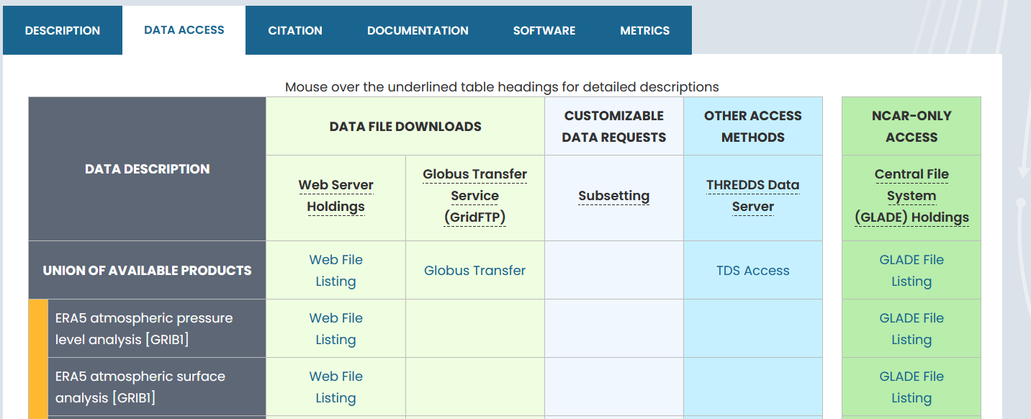
Step 1: Attaining Atmospheric Data
You need your three data types: Pressure Level, Surface, and Invariant
Navigate to the “DATA ACCESS” tab of the NCAR ERA5 listing
Click the “Web File Listing” on the top dataset: “ERA5 atmospheric pressure level analysis”
Click the “LINK” under the “Faceted Browse” option

Slide 6
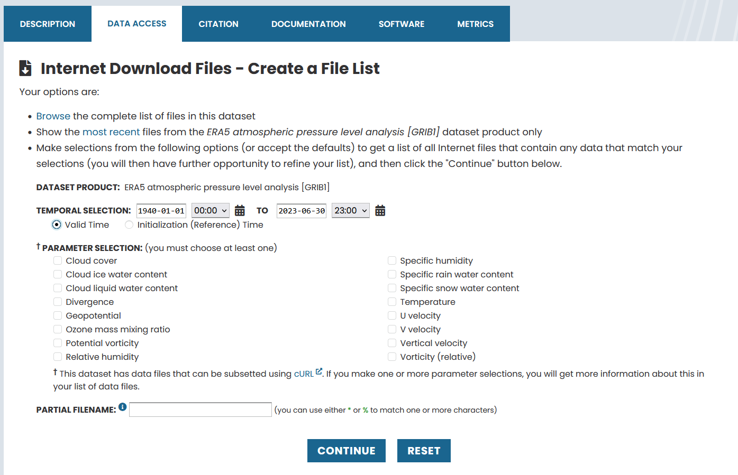
Step 1: Attaining Atmospheric Data
After clicking the “Faceted Browse” you should see a screen like below
Put in your simulation period in the “TEMPORAL SELECTION”
Check each variable under “PARAMETER SELECTION”
Click “CONTINUE”

Slide 7
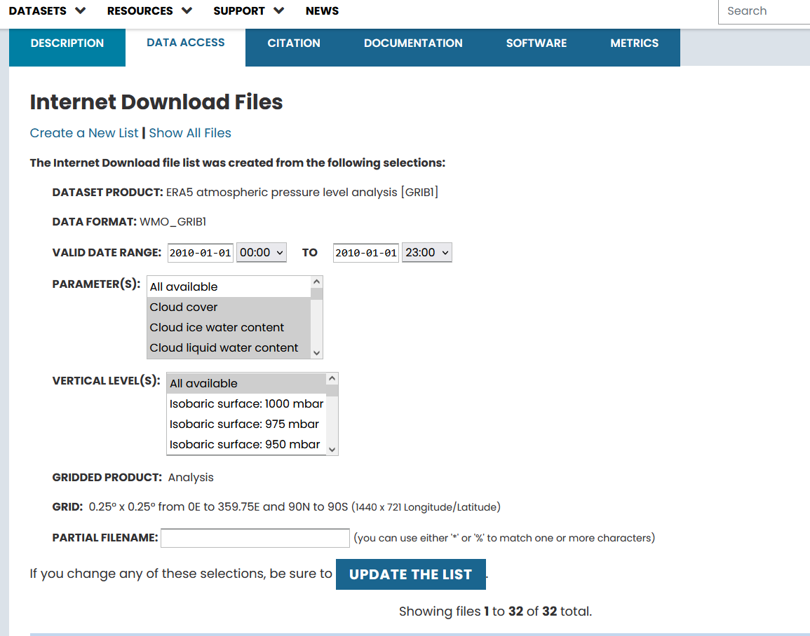
Step 1: Attaining Atmospheric Data
Your screen should look similar to the image but for your own dates.
Scroll down and see all the files you have.

Slide 8
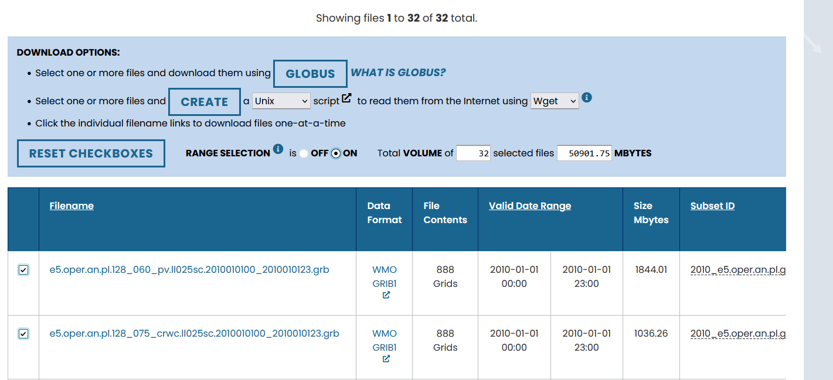


Step 1: Attaining Atmospheric Data
You’re going to generate a script to download all the data.
Note, if you have multiple pages worth of files, you’ll have to generate a script for every page. It’s really annoying
Select every file’s checkbox on the page (left of file name). This is easiest with “RANGE SELECTION ON” within the “DOWNLOAD OPTIONS” box

Slide 9
Step 1: Attaining Atmospheric Data
With the page’s files all selected go to the “DOWNLOAD OPTIONS” box.
Using the middle bullet. Click “CREATE” with a Unix script using Wget

Slide 10
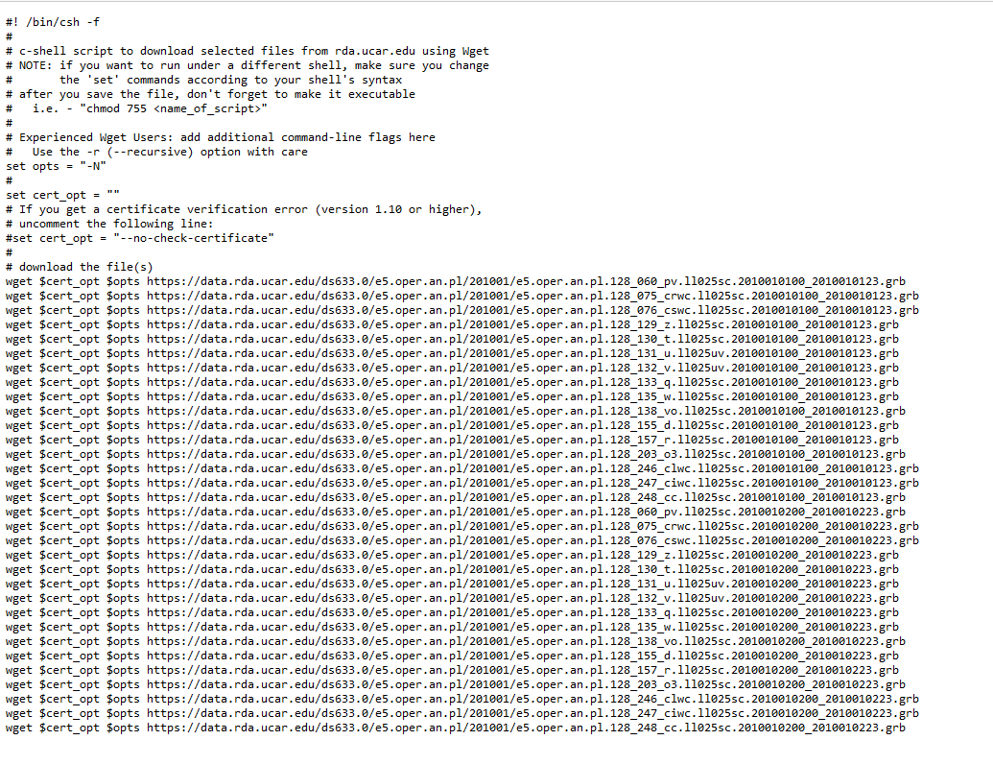
Step 1: Attaining Atmospheric Data
The resulting webpage should open in a new tab looking like this to the right
Now you’re going to copy and paste this to SMIC
To do so, log into SMIC and navigate to your WPS directory. Create a new directory called “boundary_condition_data”

Slide 11
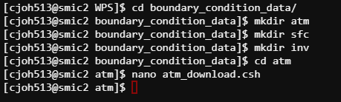
Step 1: Attaining Atmospheric Data
Move into the “boundary_condition_data” directory
Make 3 directories: “atm”, “sfc”, “inv”
These will correspond to the various data types you’ll need
Move into the “atm” directory as we are presently trying to download the pressure level (atmospheric) data
Using nano, open a new file called “atm_download.csh”

Slide 12
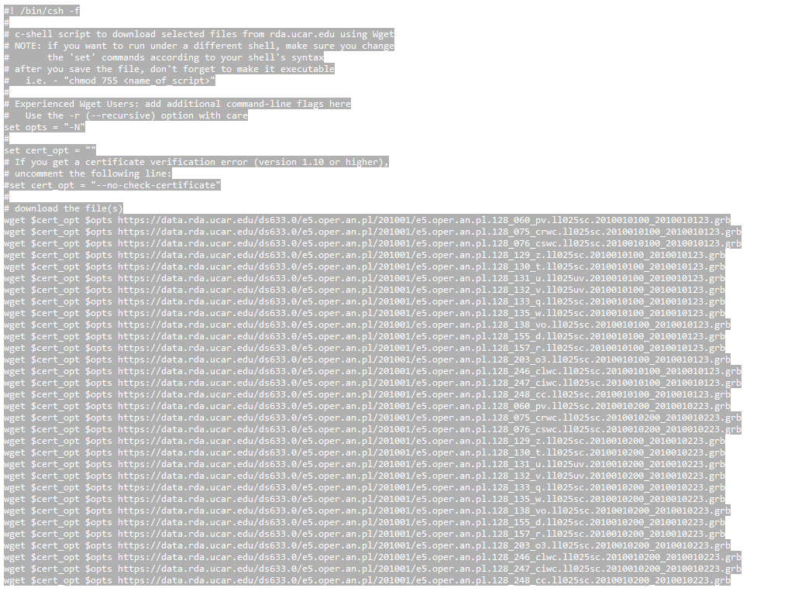
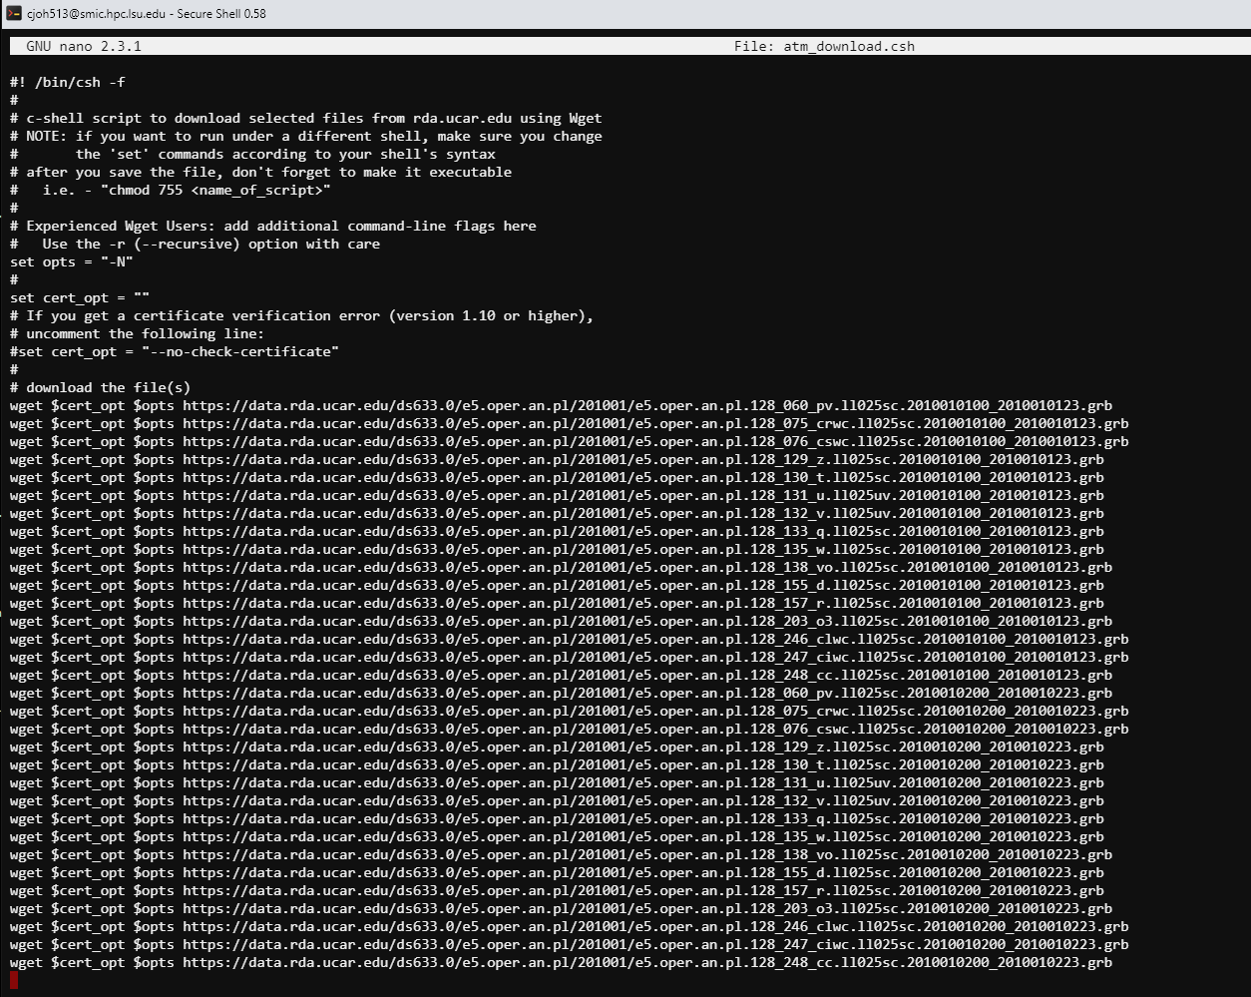
Step 1: Attaining Atmospheric Data
With the atm_download.csh file opened with nano,
Copy and paste all lines from the webpage to your atm_download.csh file (once copied, usually right click pastes inside SMIC)

Slide 13
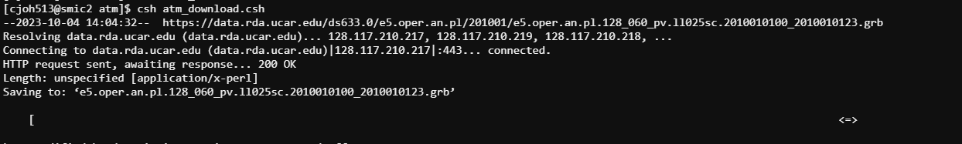
Step 1: Attaining Atmospheric Data
Once copied over to the atm_download.csh, use control+x to close the file making sure to save.
Type
csh atm_download.csh
Your files should start downloading one-by-one.

Slide 14
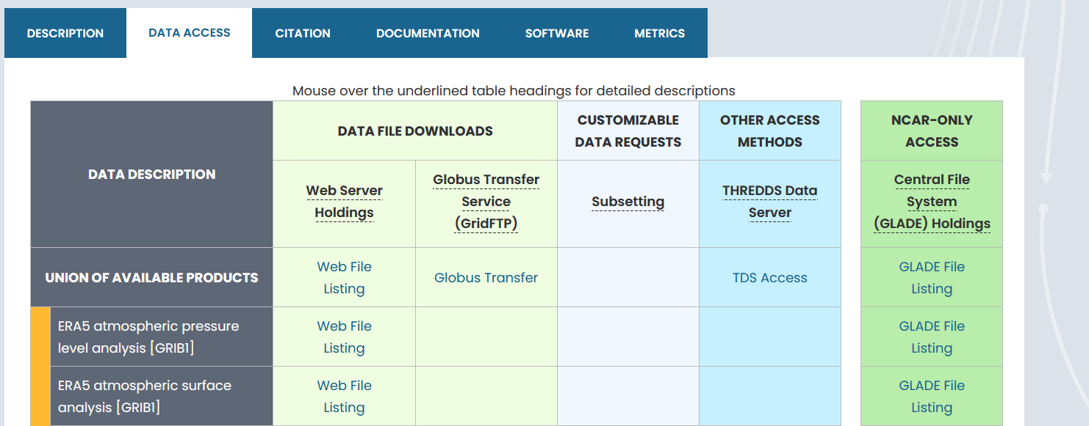
Step 1: Attaining Surface Data
If you have multiple pages worth of data (slide 8) you’ll need to create a script for each page’s data
Remember, this was just for the pressure level/atmospheric data. You need to go through the exact same steps for the single-level/surface data.
The surface data is available under the “ERA5 atmospheric surface analysis”
For the surface data, make sure you download it to
<path to your WPS>/boundary_condition_data/sfc

Slide 15
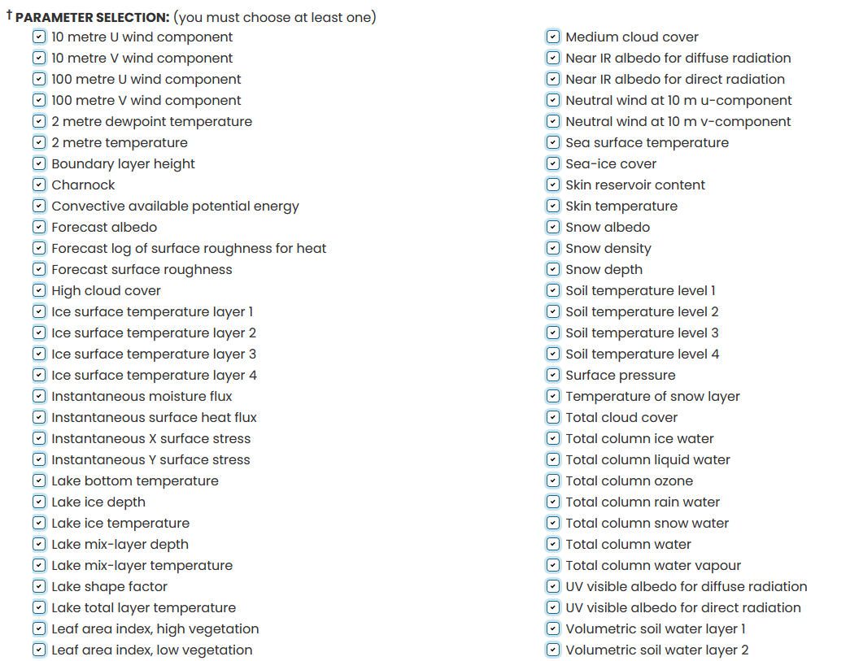
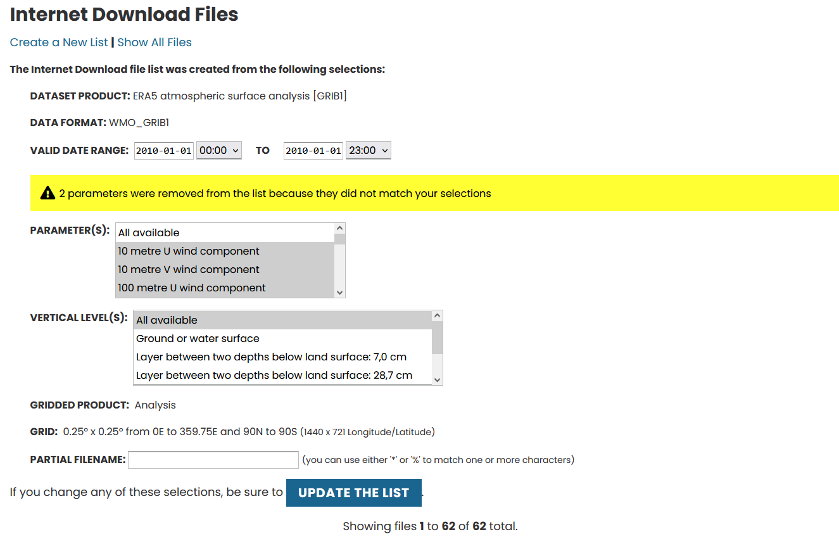
Step 1: Attaining Surface Data
When selecting the parameters for the surface data, there will be many many more options. Select them all.
If you see a yellow warning, it’s perfectly fine. Just ignore it and keep going.

Slide 16
Step 1: Attaining Invariant Data
Under the data access tab, scroll down to the “ERA5 atmospheric invariant fields [GRIB1]”
Click the “Web File Listing”
Click the “LINK” under the “Complete File List”
This will pull up 14 files. These are the ERA5 invariant files. You only need 1 of them. The land-sea mask.
It should be file number 13, but double check that it matches
e5.oper.invariant.128_172_lsm.ll025sc.1979010100_1979010100.grb

Slide 17
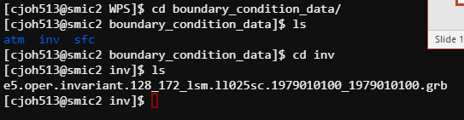
Step 1: Attaining Invariant Data
Download the “e5.oper.invariant.128_172_lsm.ll025sc.1979010100_1979010100.grb” file.
Upload it via WinSCP or Filezilla to the “<path to your WPS>/boundary_condition_data/inv” directory.

Slide 18
Step 2: WPS

Slide 19
Step 2: WPS Geogrid
Remove any “GRIBFILEs”, “met_ems”, “Vtable”, “geo_ems” from your WPS directory
Open your namelist.wps generated with the WRFDomain Wizard
You’ll likely want to remove the following lines from the namelist.wps
opt_output_from_geogrid_path
opt_geogrid_tbl_path
opt_output_from metgrid_path
opt_metgrid_tbl_path
If curious, what each of these does is in the slide notes
Notes:
Opt_output_from_geogrid_path dictates where you want to send the files generated with geogrid once generated. If the line is deleted it keeps them in the WPS directory
Opt_geogrid_tbl_path: sets the path for the geogrid table. Deleting this line makes it use the geogrid directory within WPS, this is what you want as the directory generated by WRFDomain Wizard (what this defaults to when namelsit.wps is generated) does not actually have a geogrid table.
Opt_output_from_metgrid_path: Same thing as the opt_output_from geogrid_path. It dictates where the met_ems get placed when generated. Deleting it makes it leave them in the WPS directory
Opt_metgrid_tbl_path: Same thing as the opt_geogrid_tbl_path, the directory generated by WRFDomain Wizard does not have an actual METGRID.TBL so deleting it makes you use the METGRID.TBL within WPS (located in the <path to your WPS>/metgrid/METGRID.TBL)

Slide 20
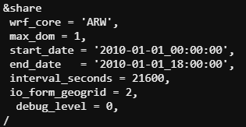
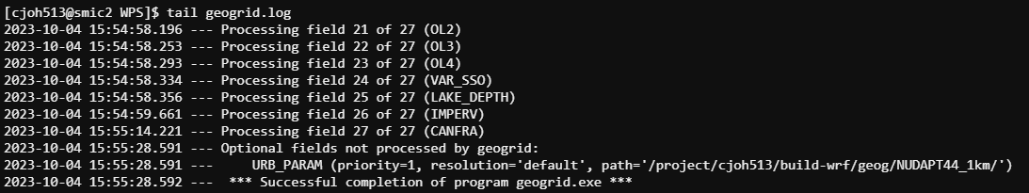
Step 2: WPS Geogrid
Open namelist.wps with nano
Set your dates in the “&share” section.
In my case, I’m just running a simple 18-hour simulation
Make sure your “geog_data_path” is set properly
Close and save your namelist.wps
Run geogrid
./geogrid.exe
If successful you should receive a message and a “geo_em.d01.nc” in the WPS directory

Slide 21

Step 2: WPS Ungrib atm
You’ll need to run ungrib.exe for each dataset you downloaded
atm, sfc, and inv
We’ll start with the atmospheric data first.
Open namelist.wps with nano
look at the “&ungrib” section.
Set the “prefix= ” option to “ATM”
This dictates what the ungribbed output file will be named.
Close and save the namelist.wps

Slide 22
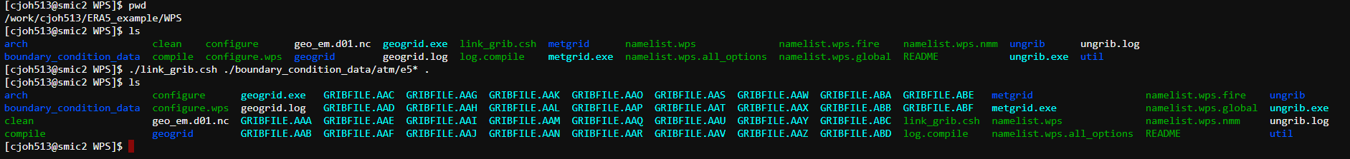
Step 2: WPS Ungrib atm
While within the WPS directory, use the following command to link the atmospheric data as GRIBFILEs for ungrib to read
./link_grib.csh ./boundary_condition_data/atm/e5* .
Type “ls” to make sure all your atm files are linked correctly as GRIBFILEs

Slide 23
Step 2: WPS Ungrib atm
Next, link your Vtable.
You may not want ERA5 sea surface temperatures (SSTs). Stop here and see the speaker notes for this slide, then follow the red slides.
If you decide you want the ERA5 SSTs continue with this slide and ignore the red slides.
With the ERA5 dataset you’ll be using the “Vtable.ECMWF”
From the WPS directory link the Vtable with the following command
ln –sf ./ungrib/Variable_Tables/Vtable.ECMWF Vtable
Run ungrib
./ungrib.exe
Notes:
SSTs can be annoying in a simulation, especially ERA5 SSTs. WRF can put in its own climatologic-based SSTs which can be better for your simulation. Below outlines why, and when you should use these over ERA5’s SSTs. However, it won’t matter for most of your simulations, and you can just skip past the red slides ignoring this and using ERA5 SSTs.
Do you need to worry about this? ERA5 SSTs?
First, consider the relevancy of SSTs within your simulation. Will SSTs be an important factor in altering the atmospheric phenomena you’re studying? Is your simulation entirely over land? Over the coast or an island? Are you looking at a hurricane? Most importantly, what is the duration of your simulation?
SSTs change slowly over time, and over the span of a few days, they’re not likely to be drastically altered. This means that WRF doesn’t “update” SSTs in your simulation very often. By default, in fact, WRF barely touches SSTs, and you must manually set variables in your namelist.input if you want SSTs updated on a frequent basis. This is because many simulations are short-term and differences in SSTs across three days (for example) are likely negligible. For most short-term simulations it doesn’t matter if you’re using climatological SSTs or ERA5 Reanalysis SSTs that come with the surface boundary condition data. In fact, it is easier to just use ERA5 SSTs because it’s all built into the dataset and Vtable.
If you’re running a short simulation over land or are otherwise not focused on the ocean, then you can probably just finish the instructions on this slide and skip all the red slides.
If you’re running a longer simulation where SSTs might update or feature coastal phenomena or focus on other SST altering phenomena, then read on. Though you still may decide you can charge ahead with ERA5 ssts.
If SSTs are going to be relevant in your simulation, I would recommend just keeping the ERA5 SSTs as normal (finish the rest of the steps on this slide then ignore the red slides) but double-check the met_ems. Compare the LANDMASK/LANDSEA to the SSTs. If you see discrepancies in what is considered land versus sea come back here and follow the steps in the red slides to use WRF’s climatological SSTs. You may also want to contact Paul or myself if you’re unsure
So why would you want to use WRFs SSTs if ERA5’s are easier and more accurate?
Two reasons:
First, they can be finicky in the metgrid step of WPS as you’ll see later in the slides
Second, when examining met_ems generated with ERA5’s surface boundary condition data (that you acquired earlier) I have found the occasional incongruity between SSTs and the LANDMASK/LANDSEA regarding what is considered land.
For example, there is an island chain to the east of Puerto Rico. At the resolution of the model I was creating, the LANDMASK/LANDSEA considered these islands water. The SSTs thought they were land, resulting in no SSTs being generated over these islands. This now meant that the simulation had a spot of water (near the research area) that had 0K temperatures and obviously created some problems. Especially when Hurricane Harvey showed up.
For more info look at these two wrf forum posts
https://forum.mmm.ucar.edu/threads/era5-landsea-mask-pulling-from-landmask-variable-instead-of-the-invariant-file.13144/
https://forum.mmm.ucar.edu/threads/altered-sst-cells-cause-simulation-to-break-several-years-into-run.13827/#post-34631
if interested, This command (ln –sf) “symbolically” links the ECMWF vtable located in the ungrib/Variable_Tables directory and calls it “Vtable”
The original Vtable.ECMWF is still in its original location. If we were to change the Vtable.ECMWF this linked file would be altered as well

Slide 24
Ungrib Without Inputting ERA5 SSTs
So, you’re going to use WRF’s climatologic-based SSTs
This is not actually very difficult to set, but it’s important to stay organized with your Vtables.
In your WPS directory, check if you have any “Vtables” with the command “ls”
If you do, remove it with “rm”

Slide 25
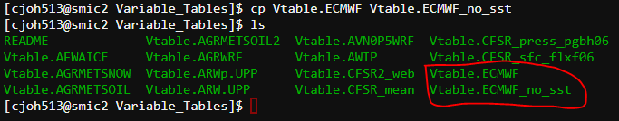
Ungrib Without Inputting ERA5 SSTs
Navigate from the WPS directory to your Variable Tables with
cd ./ungrib/Variable_Tables/
Type “ls” to see the different types of Vtables corresponding to different datasets
Copy the ECMWF Vtable but call it something else
cp Vtable.ECMWF Vtable.ECMWF_no_sst
Now open Vtable.ECMWF_no_sst with nano

Slide 26
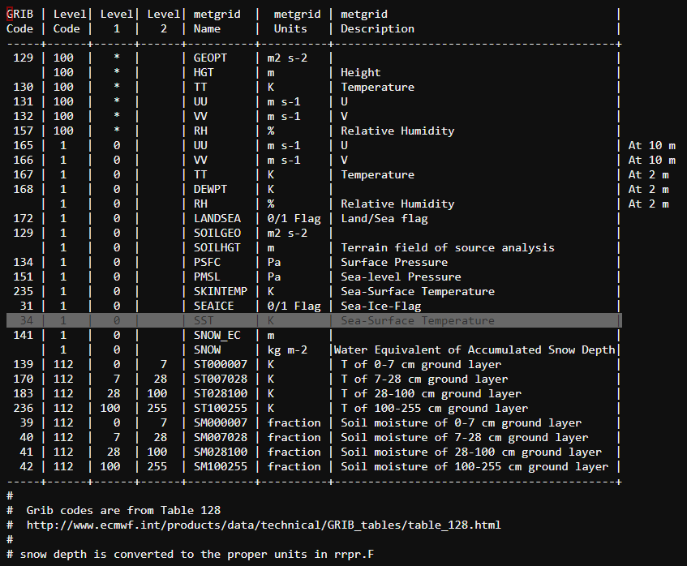
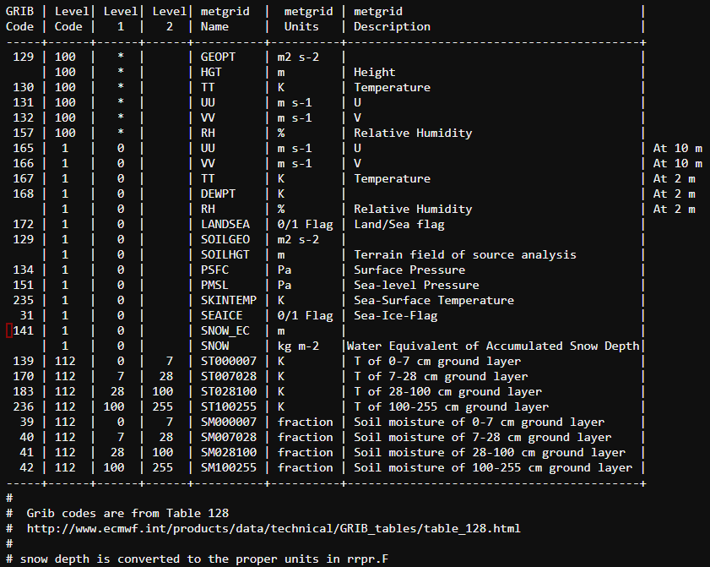
Ungrib Without Inputting ERA5 SSTs
Your Vtable will look like the left image.
Delete the highlighted line.
Close and save
Notes:
The Vtable tells what variables the ungrib process looks for based on the “GRIB Code”. By removing the SST (GRIB Code 34), the ungribbing process won’t look for SSTs within the boundary condition data and later when you use metgrid, WRF will substitute its own climatological SSTs.

Slide 27
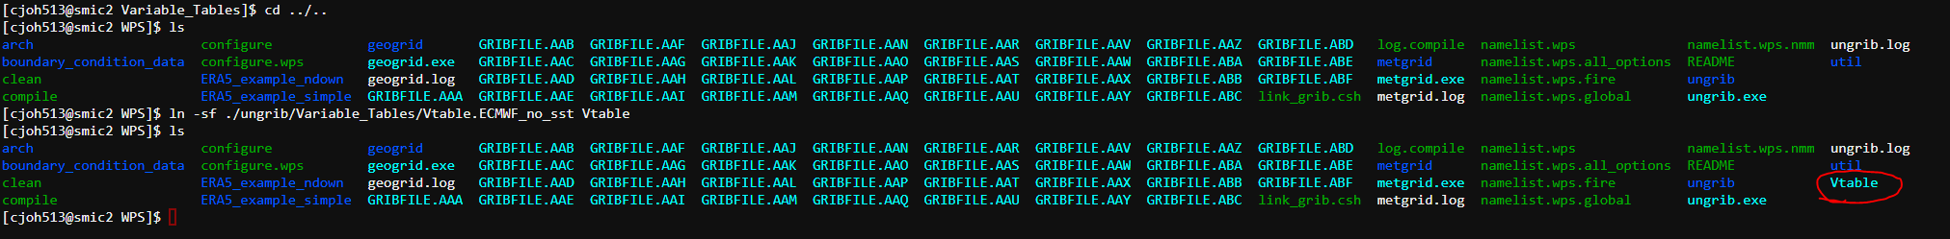
Ungrib Without Inputting ERA5 SSTs
Navigate back to your WPS directory
cd ../..
Link the Vtable you just created to your WPS directory
ln –sf ./ungrib/Variable_Tables/Vtable.ECMWF_no_sst Vtable
Run ungrib
./ungrib.exe

Slide 28
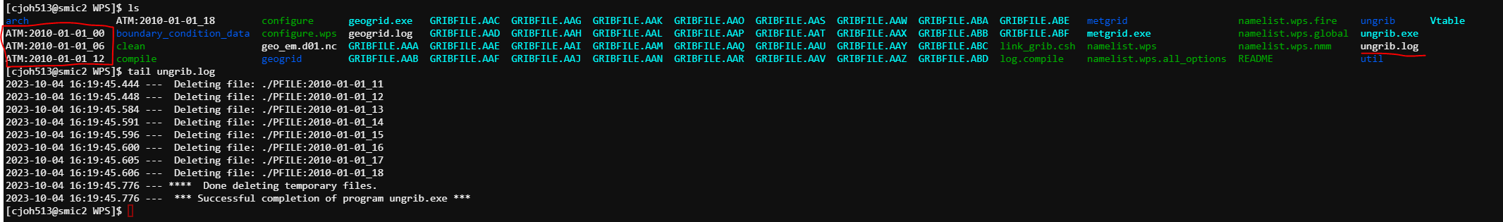
Step 2: WPS Ungrib atm
Check if ungrib ran properly
There should be ATM files and the ungrib.log should end in a successful message

Slide 29

Step 2: WPS Ungrib sfc
Next, we’re going to do the same thing that we did for the atm files for the sfc files.
You’ll keep the same Vtable, so all you’re altering are the GRIBFILEs, and the ungrib output name.
Remove the current atm GRIBFILEs from the WPS directory with
rm GRIBFILE.*
Open namelist.wps with nano
Alter the “prefix=‘ATM’,” in the “&ungrib” section to be “SFC”
Close and save namelist.wps

Slide 30
Step 2: WPS Ungrib sfc
Link the Surface data with the same command we linked the atmospheric data.
./link_grib.csh ./boundary_condition_data/sfc/e5* .
There will probably be more GRIBFILEs than with the atmospheric data.
Run ungrib with
./ungrib.exe

Slide 31
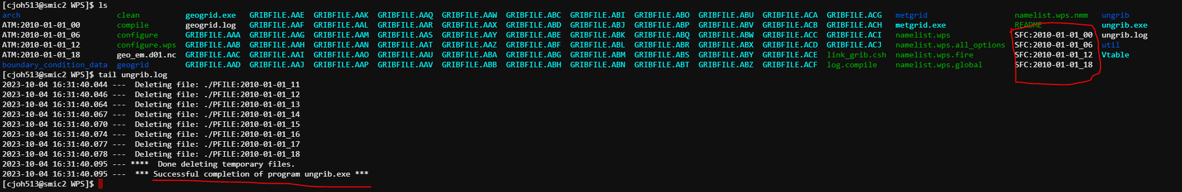
Step 2: WPS Ungrib sfc
Check if ungrib ran correctly
Now there should be an equal number of SFC files to ATM files

Slide 32
Step 2: WPS Ungrib inv
The invariant file works a little differently than the ATM and SFC files
This is a static field that doesn’t change regardless of the duration of the simulation
This means we’ll need to alter the dates within namelist.wps
Remove the current sfc GRIBFILEs from the WPS directory
Link the invariant file to the WPS directory
./link_grib.csh ./boundary_condition_data/inv/* .

Slide 33
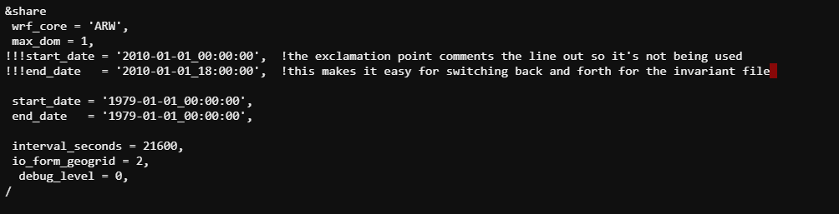

Step 2: WPS Ungrib inv
Open the namelist.wps with nano
Change the start date and end date to 1979-01-01_00:00:00
Change “prefix” in the “&ungrib” section to “INV”
Close and save namelist.wps
Run ungrib
./ungrib.exe

Slide 34
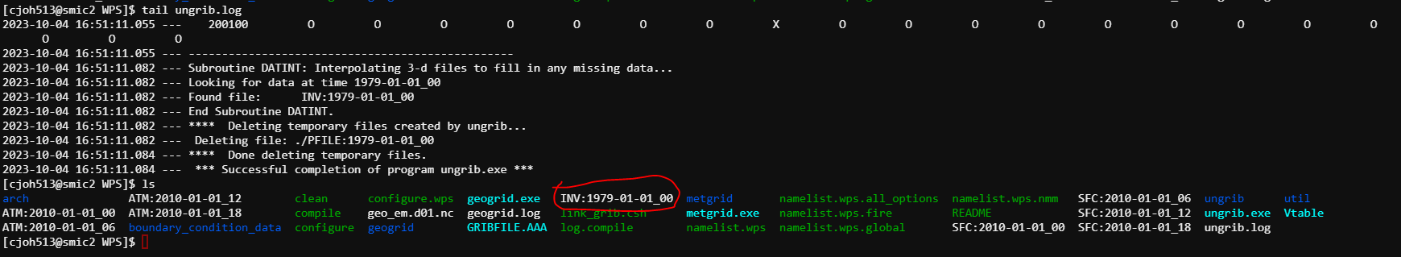
Step 2: WPS Ungrib inv
Check if ungrib ran properly
There should now be a single INV:1979-01-01_00 file

Slide 35
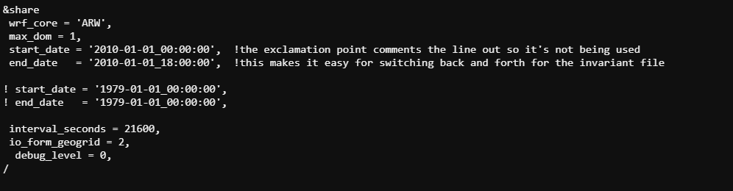
Step 2: WPS Metgrid
Open your namelist.wps
Set the start and end dates back to your simulation period.

Slide 36
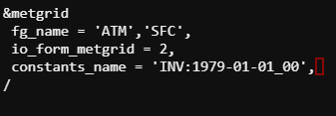
Step 2: WPS Metgrid
Under the “&metgrid” section
If present, delete the
“opt_output_from_metgrid_path”
“opt_metgrid_tbl_path”
Change “fg_name” from “FILE” to
‘ATM’, ‘SFC’,
Add the following line
constants_name = ‘INV:1979-01-01_00’,
Close and save namelist.wps

Slide 37
Step 2: WPS Metgrid
Now you’re going to alter the METGRID.TBL
This is a step I recommend, but not fully necessary.
In the METGRID.TBL you’ll be able to tweak the weight of variables, how smooth the land/ocean boundary is, how blocky sea surface temperatures are, etc.
A common variable to tweak is sea surface temperature (SST)
It is crucial you look at your met_ems in Panoply after you use metgrid
As the old saying goes, garbage data in = garbage data out.
If your met_ems look weird, then your wrf simulation is going to look weird.
Ask for help too if your met_ems are turning out strange. Probably don’t just go messing around in the METGRID.TBL

Slide 38
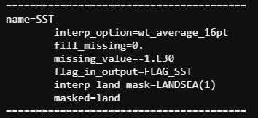
Step 2: WPS Metgrid
From your WPS directory open the METGRID.TBL
nano ./metgrid/METGRID.TBL
use the arrow keys or page-down to navigate down until you find the SST variable
Set the variable to look like the one here
Close and save METGRID.TBL
Run metgrid.exe with
./metgrid.exe

Slide 39
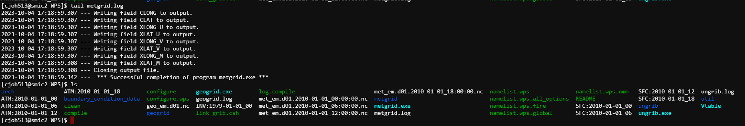

Step 2: WPS Metgrid
Check metgrid.log to see if it ran properly
Your met_em files should appear in the WPS directory

Slide 40
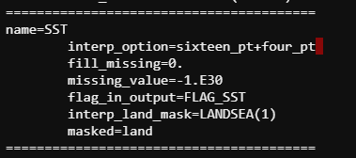
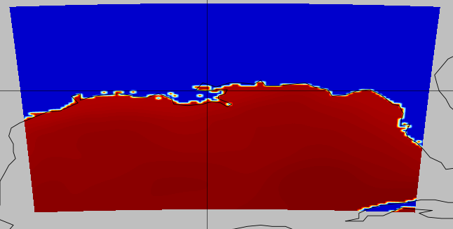
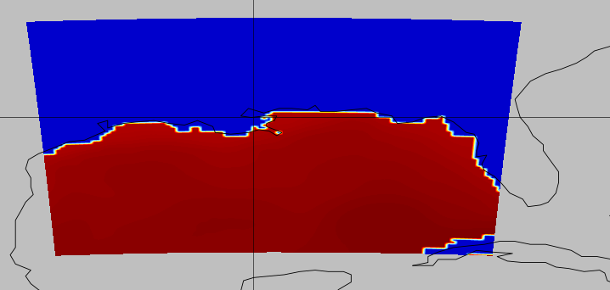
Step 2: WPS Metgrid
Here’s an example of how different METGRID.TBL weights with SSTs can alter the met_em file
On a higher resolution or smaller domain, impacts are more stark

Slide 41
Step 3: WRF

Slide 42
Step 3: WRF Real
Navigate to your <path to your WRF>/run directory.
Copy your namelist.input from the directory generated by the WRFDomain Wizard to your run directory.
Set your start/end dates.
Choose the necessary parameterization schemes for your simulation.

Slide 43
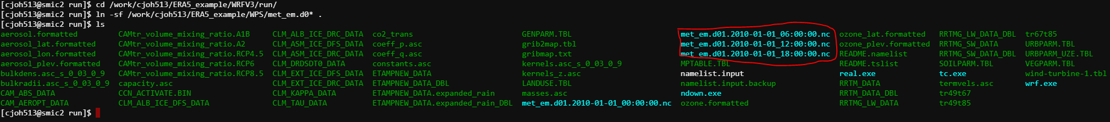
Step 3: WRF Real
From your <your path to WRF>/run directory
Link the met_ems you generated in WPS
ln –sf <path to your WPS directory>/met_em.d0* .
Double check your namelist.input
Run real.exe
./real.exe

Slide 44
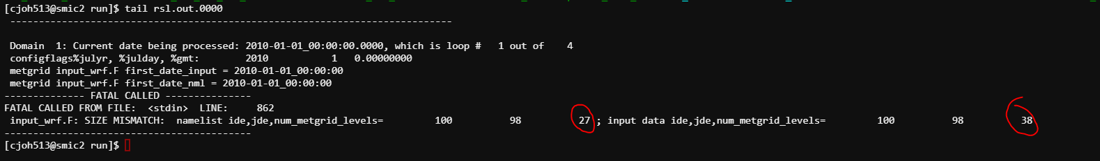
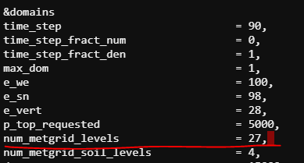
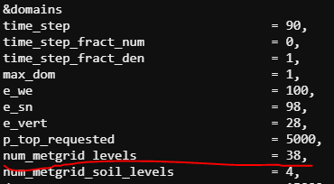
Step 3: WRF Real Troubleshooting
Often, you’ll encounter little errors resulting from the pre-generated namelist with WRFDomain Wizard. Commonly, a num_metgrid_levels mismatch.
This is a simple fix. Just open the namelist.input and set the num_metgrid_levels to what the input data expects.

Slide 45
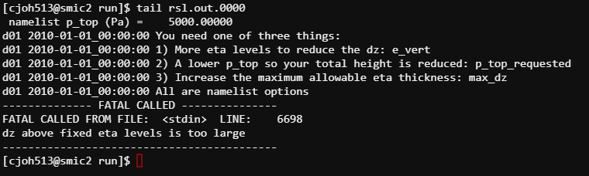

Step 3: WRF Real troubleshooting
Another common error:
Luckily, this error actually provides recommendations with how to fix.
In my case I set my e_vert from 28 to 40, and the problem was sorted
This is recommended over lowering p_top_requested because a low p_top_requested can run into errors when trying to start the actual simulation

Slide 46
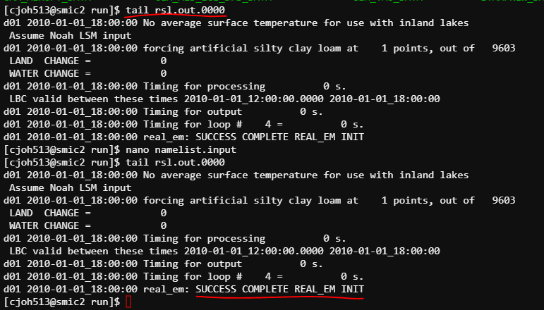
Step 3: WRF Real
Once you’ve sorted your errors, you should have a successful message in the rsl.out.0000 file.
Check to see if your input files were generated
wrfbdy_d01
wrfinput_d01
wrfinput_d0… if multiple domains

Slide 47
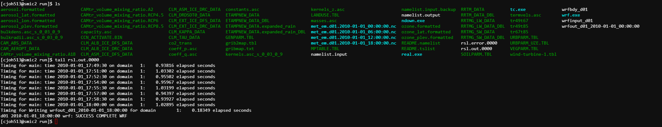

Step 3: WRF
Run WRF
./wrf.exe
Although, more likely you’ll need to submit a .pbs job for a large simulation
Check your rsl files for a successful completion and check to see if you have “wrfout” files

